Slide 1
Tuesday, October 24, 2017
Write In Your Agenda:
Write In Your Monitoring Log:
CW:
Mercalli & Me!
Earthquakes Word Search and Crossword
HW:
Review Earthquake notes for Quiz tomorrow!
Response to Warm-Up:
What are the similarities between the Richter Scale and the Mercalli Scale?
You will need:
Pencil
Agenda
Monitoring Log

Slide 2
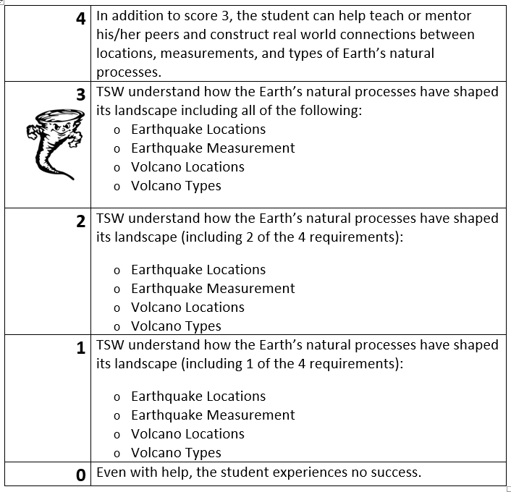
Learning Goal and Scale
TSW understand how the Earth’s natural processes have shaped its landscape (including Earthquake locations and how they are measured as well as Volcano locations and the three types).

